Slide 1


Slide 2

#LifeKoKaroLift
SGC Coaching:
Articulate your Journey | Activate Your Vigour| Accelerate Mutual Growth
Session 15
Time Series Analysis

Slide 3
Agenda
Quick Recap – (15 min)
Focused Teaching (60 min)
Doubts Resolutions (15 min)
Time Series Analysis
doubts resolutions
Last 2 weeks

Slide 4
Recap: What the learner have learnt in the week
Quick Glance at Key Learnings
Regularization
Good Fit
Time Series
Evaluation
RMSE
MASE
Over Fit
Basic Understanding
Under Fit
Why we needed?

Slide 5
Focus Teaching – Time Series Analysis
Time Series is a sequence of numerical data obtained at regular time intervals
Why Time series is different?
Data are not independent
Large samples sizes are good, but long time series are not always the best
Importance of Time series analysis.
Understand the Past
Forecast the Future
Notes:
Much of the statistical theory relies on the data being independent and identically distributed
Series often change with time, so bigger isn’t always better

Slide 6
Focus Teaching –Components
Components
Long Term movement
Seasonal Variations
Cyclic Variations
Random
Short Term Movements
Trends

Slide 7
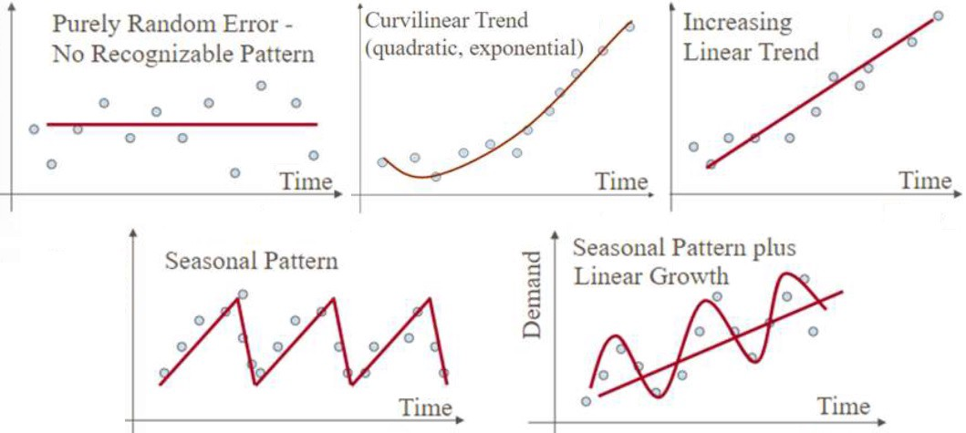
Focus Teaching – Components - Trends
Trends
The trend shows the general tendency of the data to increase or decrease during a long period of time.
A trend is a smooth, general, long-term, average tendency.
It is not always necessary that the increase or decrease is in the same direction throughout the given period of time.

Slide 8
Focus Teaching – Components - Seasonal
Seasonal
These are the rhythmic forces which operate in a regular and periodic manner over a span of less than a year.
They have the same or almost the same pattern during a period of 12 months.
This variation will be present in a time series if the data are recorded hourly, daily, weekly, quarterly, or monthly.

Slide 9
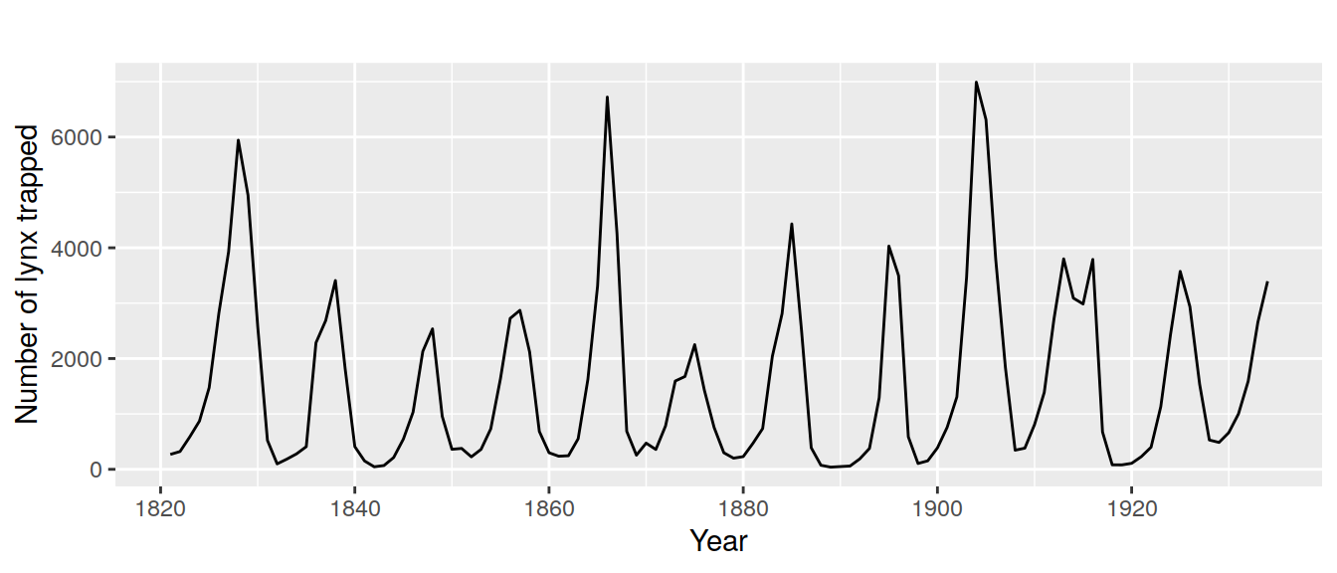
Focus Teaching – Components - Cyclical
Cyclical
The variations in a time series which operate themselves over a span of more than one year are the cyclic variations.
This oscillatory movement has a period of oscillation of more than a year.
One complete period is a cycle.
This cyclic movement is sometimes called the ‘Business Cycle’.

Slide 10
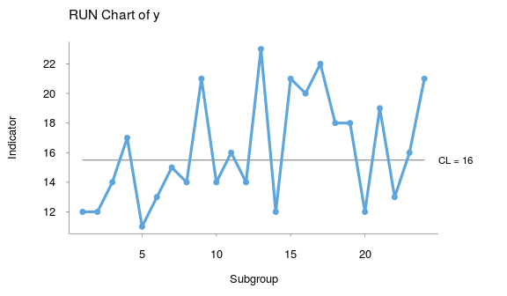
Focus Teaching – Components - Random
Random
There is another factor which causes the variation in the variable under study.
They are not regular variations and are purely random or irregular.
These fluctuations are unforeseen, uncontrollable, unpredictable, and are erratic

Slide 11
Focus Teaching – Smoothing
Smoothing
Smoothing is a technique applied to time series to remove the fine-grained variation between time steps.
The hope of smoothing is to remove noise and better expose the signal of the underlying causal processes.
Moving average
Exponential smoothing
Triple exponential smoothing
Double exponential smoothing

Slide 12
Focus Teaching – Moving Average
Moving Average: Averages of consecutive time series values for a chosen period of length L

Slide 13
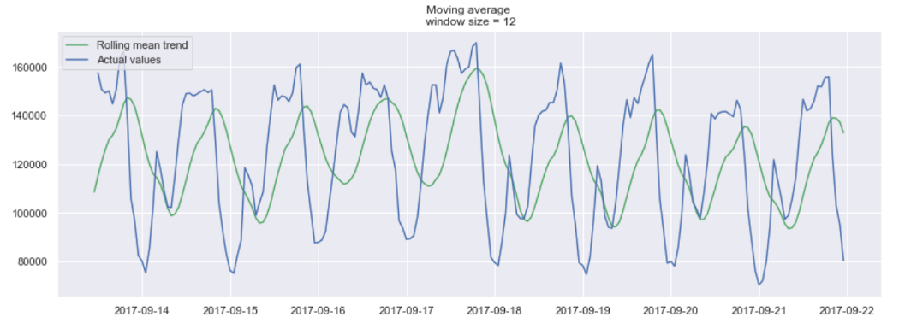
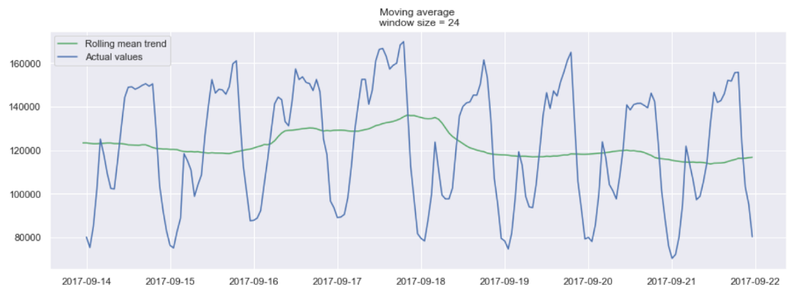
Focus Teaching – Moving Average

Slide 14
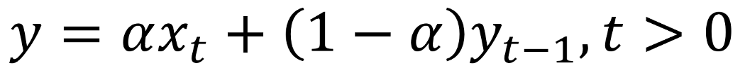
Focus Teaching – Exponential Smoothing
Exponential smoothing uses a similar logic to moving average, but this time, a different decreasing weight is assigned to each observations.
In other words, less importance is given to observations as we move further from the present.
Here, alpha is a smoothing factor that takes values between 0 and 1. It determines how fast the weight decreases for previous observations.

Slide 15
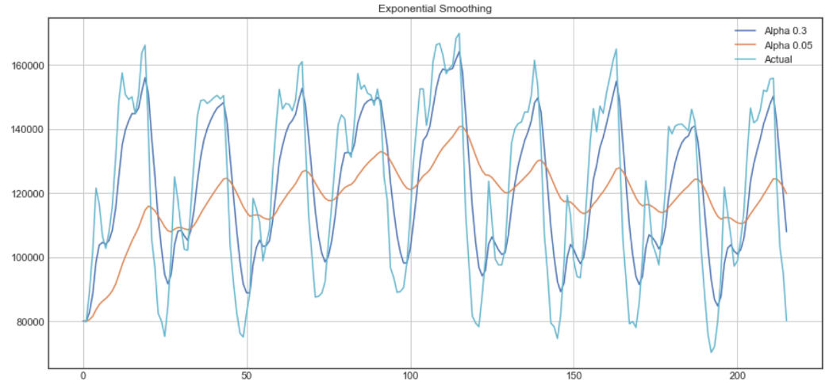
Focus Teaching – Exponential Smoothing

Slide 16
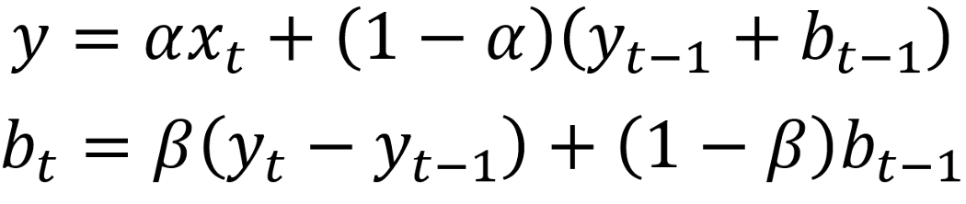
Focus Teaching – Double Exponential Smoothing
Double Exponential Smoothing
Double exponential smoothing is used when there is a trend in the time series.
In that case, we use this technique, which is simply a recursive use of exponential smoothing twice
Here, beta is the trend smoothing factor, and it takes values between 0 and 1.

Slide 17
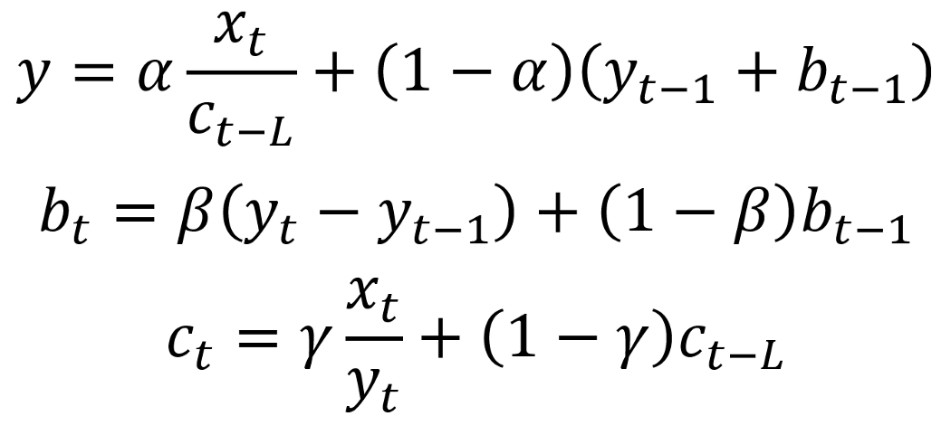
Focus Teaching – Triple Exponential Smoothing
Triple Exponential Smoothing
This method extends double exponential smoothing, by adding a seasonal smoothing factor. Of course, this is useful if you notice seasonality in your time series
Where gamma is the seasonal smoothing factor and L is the length of the season.

Slide 18
Coding Time
Coding Time
Notes:
Coding time

Slide 19

Doubts Resolutions

